Slide 1


ECEN 404 Final Presentation
Team 28: Livestock Gas Monitor Matthew Owen, Joaquin Salas, Blake Schwartzkopf, Tanmay Sarkar Sponsor: Global Hawk Solutions LLC (Justin Houck) TA: Vishwam Raval
Notes:
Michelle

Slide 2
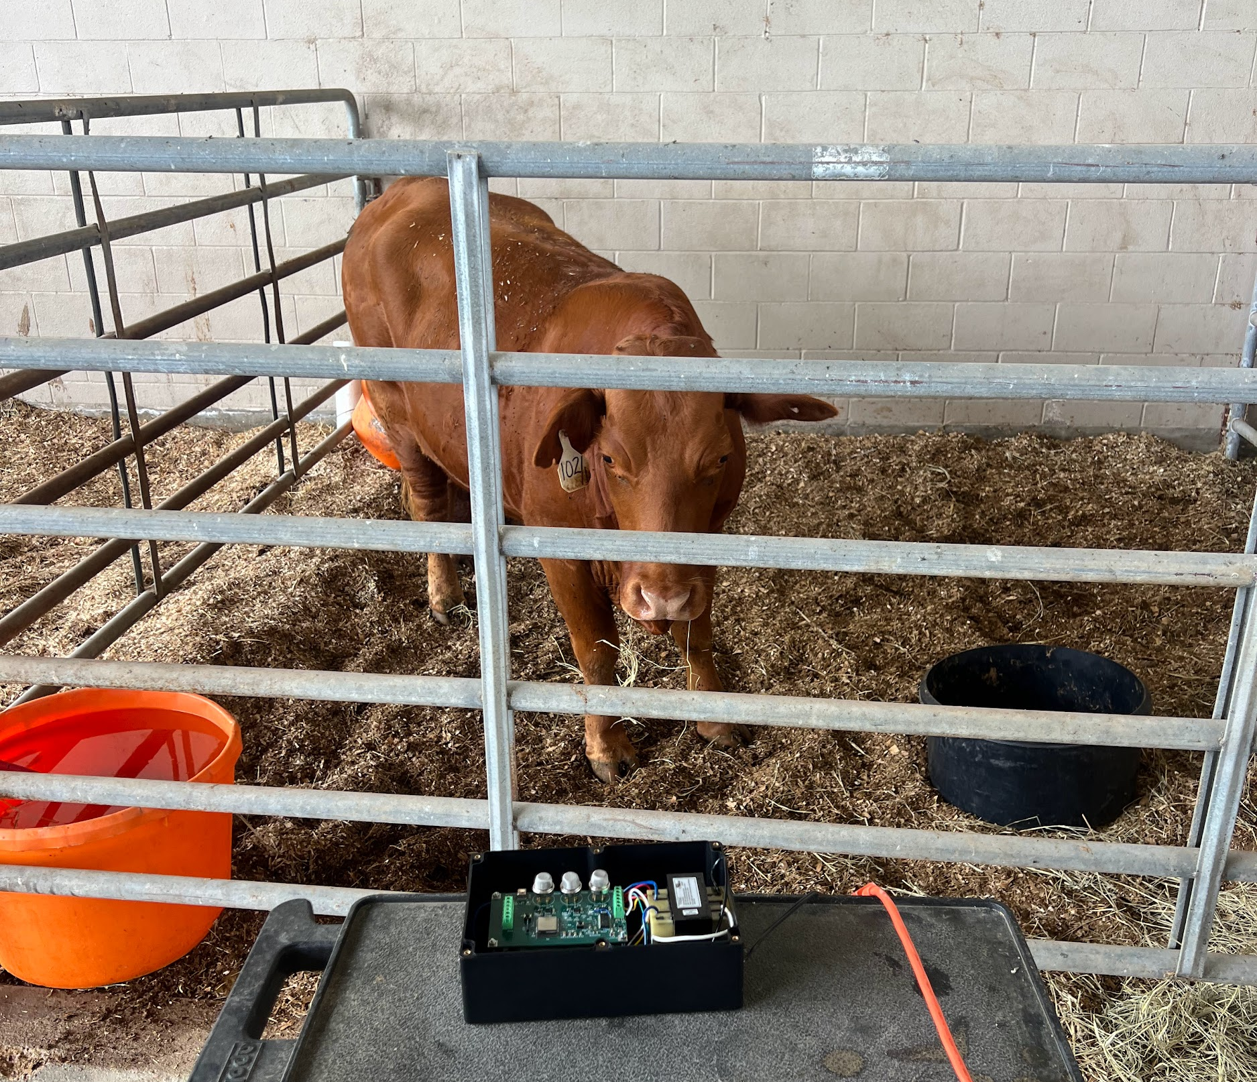
Problem Overview
Monitoring environmental conditions in animal farms.
To design and implement a durable, real-time gas monitoring system that can track harmful gases in animal farms.
Picture / Diagram here

Slide 3
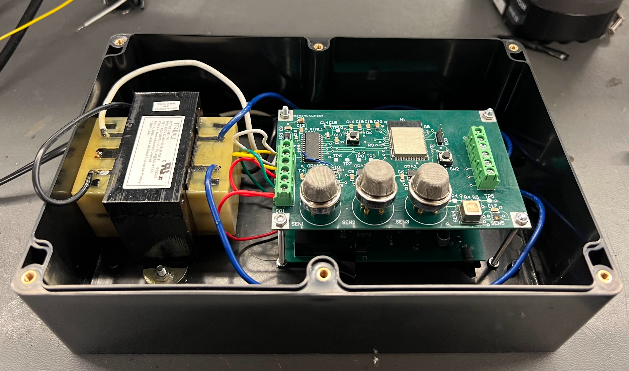
Integrated Project Diagram
Transformer
Sensor PCB
Power PCB
Wall Outlet Connection
NH3
H2S
CH4
CO2 + Temp + Humidity

Slide 4
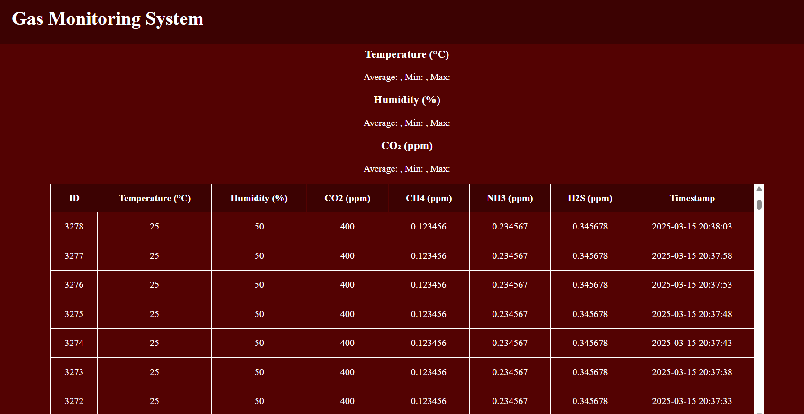
User Interface

Slide 5
Engineering Design Accomplishments
Blake
Designed 2 iterations of the sensor pcb that takes measurements of CH4, H2S, NH3, CO2, Temperature, and humidity in the air.
PCB consisted of 3 analog sensors, 2 digital I2C sensors, unity gain op amps, ADC, and microcontroller.
Created equations to convert the voltage level detected to the gas concentration in parts per million.
Challenges | Solutions
Voltage divider for ain1 not working. | Ain1 input on ADC broken, rerouted to ain4.
Analog sensors heating up the board and causing skewed temperature measurements. | External sensor in the housing unit routed to the microcontroller.
Inaccuracy in voltage to ppm calculations. | Looked over datasheet again and fixed the equations.

Slide 6
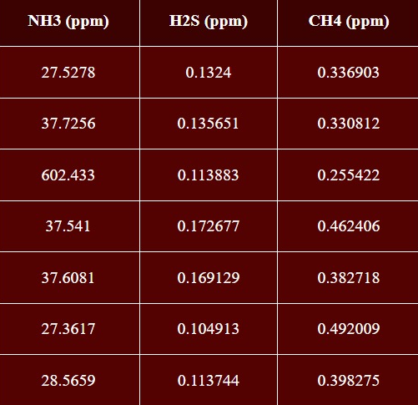
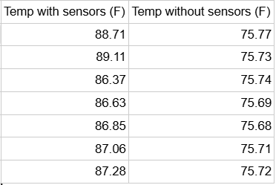
Engineering Design Accomplishments
Blake

Slide 7
Engineering Design Accomplishments
Blake
Input Value | Output Value | Corrected Value | Error (%)
0.25 | 0.272611 | 0.24996 | 0.00016
0.3 | 0.3214 | 0.299959 | 0.00014
0.35 | 0.370206 | 0.349975 | 0.00007
0.4 | 0.419002 | 0.399982 | 0.00005
0.45 | 0.467812 | 0.450002 | 0.00000
0.5 | 0.516805 | 0.500005 | 0.00001
0.55 | 0.565394 | 0.550004 | 0.00001
0.6 | 0.614412 | 0.599039 | 0.00160
0.65 | 0.6629 | 0.649928 | 0.00011
0.7 | 0.710648 | 0.699913 | 0.00012
0.75 | 0.760481 | 0.749993 | 0.00001
0.85 | 0.858065 | 0.849934 | 0.00008
0.95 | 0.955856 | 0.949924 | 0.00008
1 | 1.00447 | 1.00046 | 0.00046
1.25 | 1.24846 | 1.250016 | 0.00001
1.5 | 1.429238 | 1.499936 | 0.00004
1.75 | 1.736281 | 1.749929 | 0.00004
2 | 1.980254 | 1.999953 | 0.00002
Sent voltages to the ADC and then to microcontroller.
Corrected error and calibrated the ADC.

Slide 8
Engineering Design Accomplishments Matthew
Designed multiple iterations of power PCB to provide 5,3.3,-8 V under max current of 1A to sensor subsystem
PCB consisted of buck boost converters, AC-DC rectifiers, inverters, and filtering circuits
Fabricated a custom housing unit that securely mounted PCBs and the transformer. Wired all components in a way that protected both the parts and the connections
Challenges | Solutions
Power subsystem not handling load from sensors subsystem | Redesign pcb by removing overloaded capacitors and make changes to resistor values
Negative voltage not working | Identify and order new parts that were better suited to handle the amount of load necessary for project and revising the pcb to correct the input voltages of the inverter
Unreliable power for long periods over long periods of time | Rewired transformer and corrected all sloppy soldering points

Slide 9
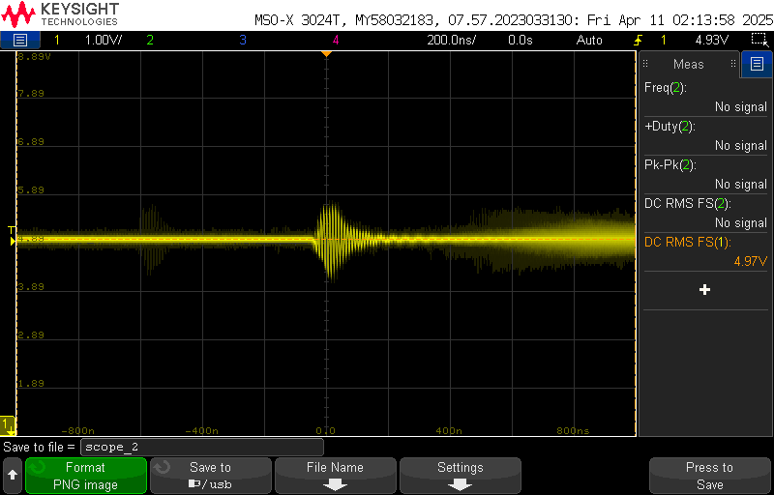
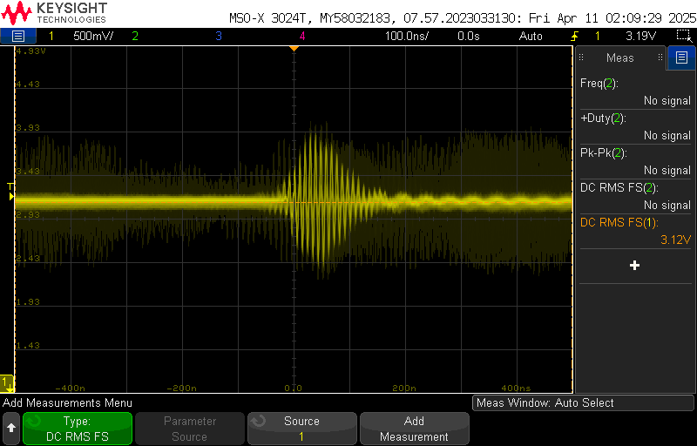
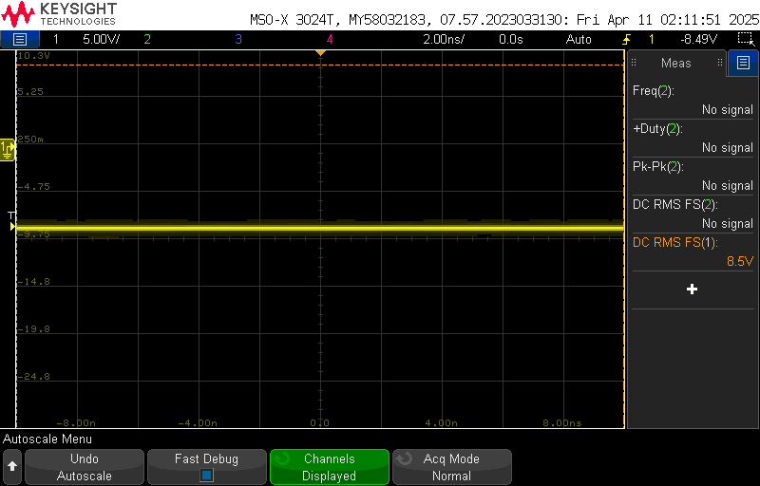
Engineering Design Accomplishments Matthew
Voltages under full load conditions have been tested and validated
5V
3.3V
-8.5V

Slide 10
Engineering Design Accomplishments - Joaquin
Programmed ESP32-S3 in ESP-IDF (C):
Several GPIO, Built in Wi-Fi/Bluetooth, low-level control, managing tasks
Integrated sensors:
I2C: HDC1000 (Temp/Humidity), SCD41 (CO₂ + Temp/Humidity)
Analog: MQ-4, MQ-136, MQ-137 via AD7718 Analog-Digital Converter
Developed Wi-Fi/MQTT transmission to AWS IoT for real time data visualization
Challenges | Solutions
Interfacing and calibrating AD7718 ADC | Referencing spec sheet to find setup processes, read/write/reset register. Improved voltage measurement with a linear calibration equation.
Wi-Fi connectivity and flexibility (no hard-coded credentials) | Integrated Wi-Fi provisioning. Added error-handling and reconnection logic to always stay online.
Replica/Repeated Data Transmissions | Implemented a mutex (semaphore) to protect shared sensor data during updates, preventing repeated or stale values from being transmitted.

Slide 11
Engineering Design Accomplishments - Joaquin
Requirement | Target Spec | Result
Read Analog Sensor Data | ±1% error max across 0-2.5V | Minimum Error: 0.000001% Maximum Error: 0.00160% Average Error: 0.00017%
Read Digital Sensor Data | Digital sensor initializes and reports valid CO₂, temperature, and humidity values | Successful sensor initialization and realistic environmental readings under test conditions
Transmit Sensor Data | Send all sensor values every 5s to AWS MQTT broker without data loss | 0 data loss, corrupted data, repeated data
Wi-Fi Range and Stability | Maintain stable transmission over extended time periods (30 min, 1 hr, 2 hrs, 3 hrs) | Successful under ideal Wi-Fi. Under busy Wi-Fi network/weak signal: Wi-Fi reconnects every 5-20 data transmissions.
 | Temp (°F) | Humidity (%) | CO₂ (ppm)
min | 76.85 | 51.55 | 390.0
max | 87.06 | 60.45 | 764.0
mean | 84.88 | 56.81 | 475.85
From 11:00 AM to 2:00 PM on April 3rd:
Temp (°F): Min = 81°F, Max = 88°F, Average = 85.25°F
Humidity (%): Min = 61%, Max = 79%, Average = 68%

Slide 12
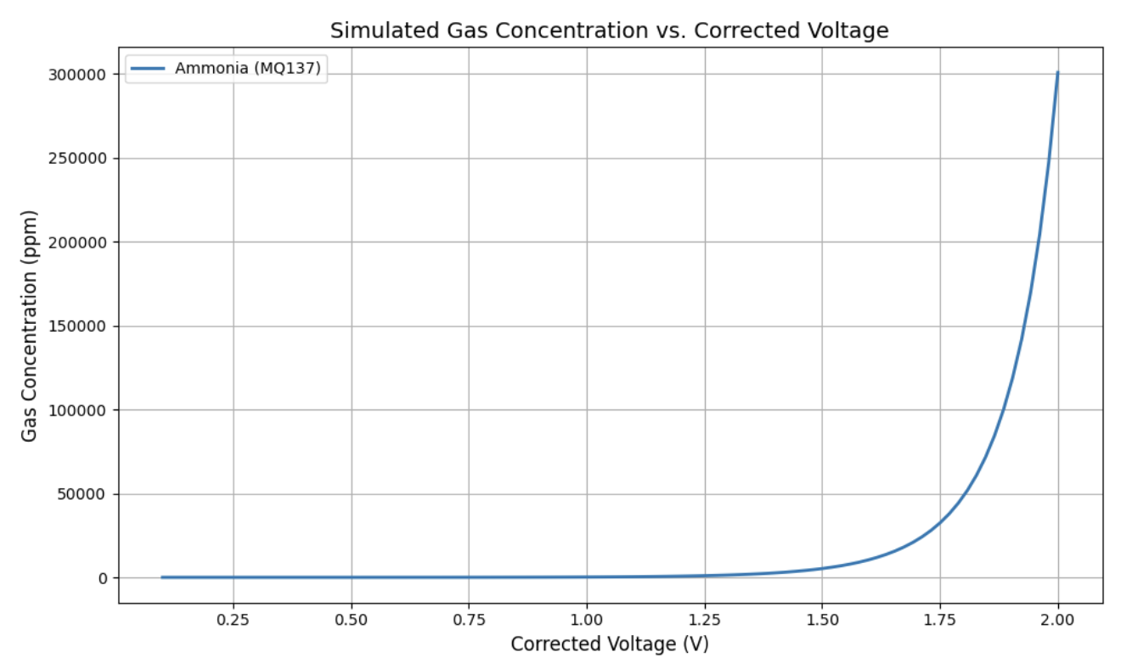
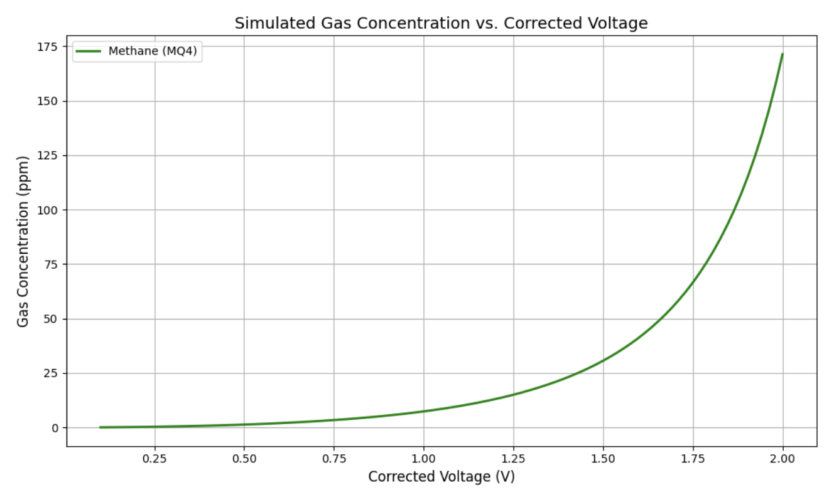
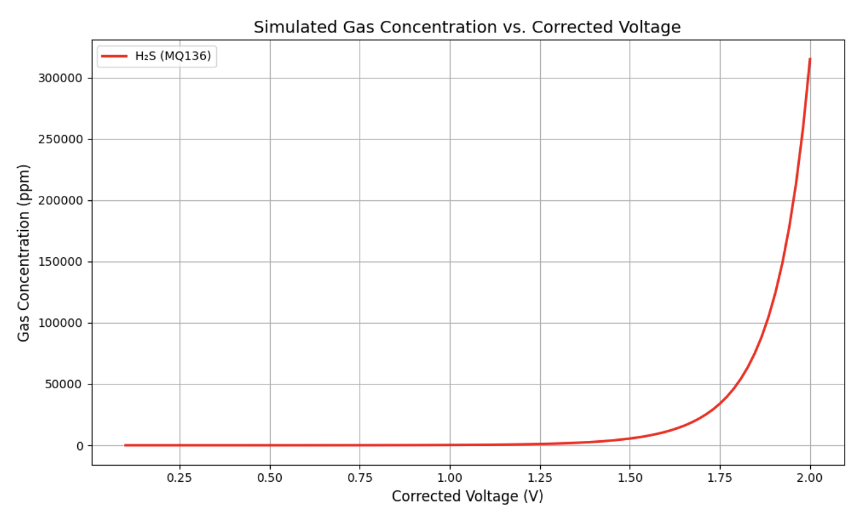
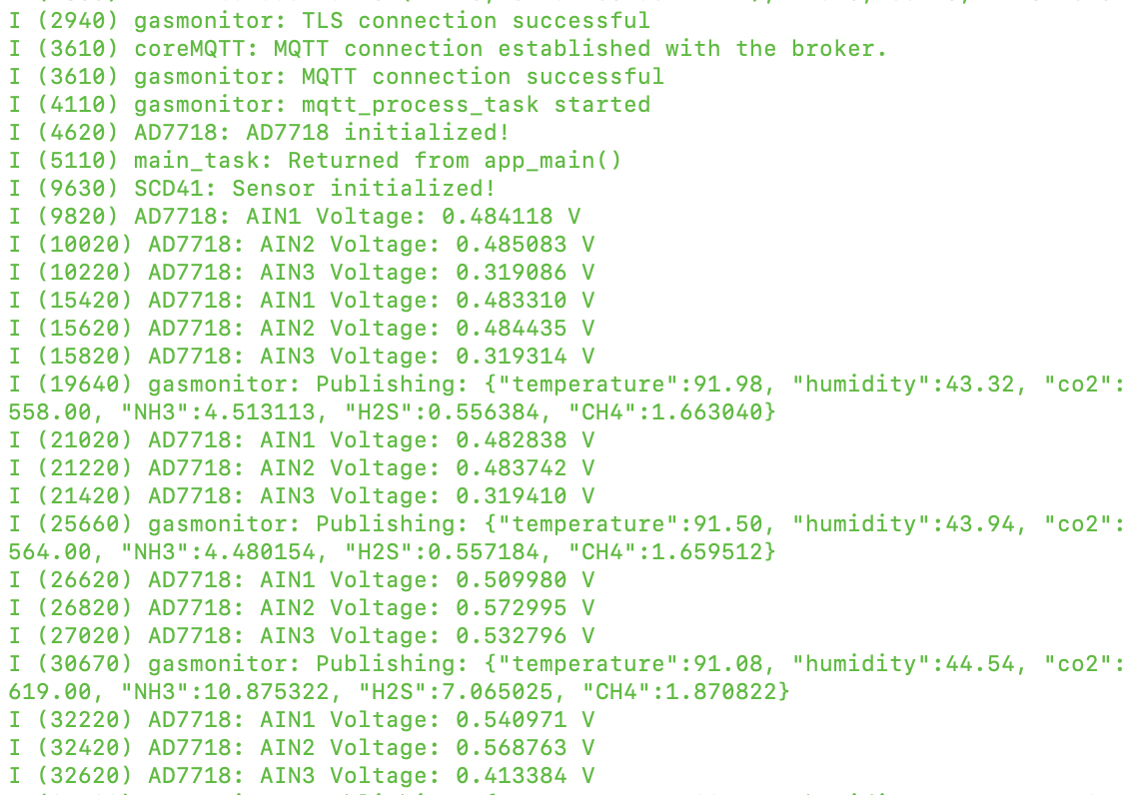
Engineering Design Accomplishments - Joaquin
Above: Equations used for calibrating gas sensors
Example Equation: Ammonia (NH₃) — MQ137 (AIN4)
PPM = 1264.231 × (Rs / 10064)^(-4.1325)
Rs = (5 − 2 × Vout) × 10000 ÷ (2 × Vout)
To the left: Gas Monitoring system fully functional

Slide 13
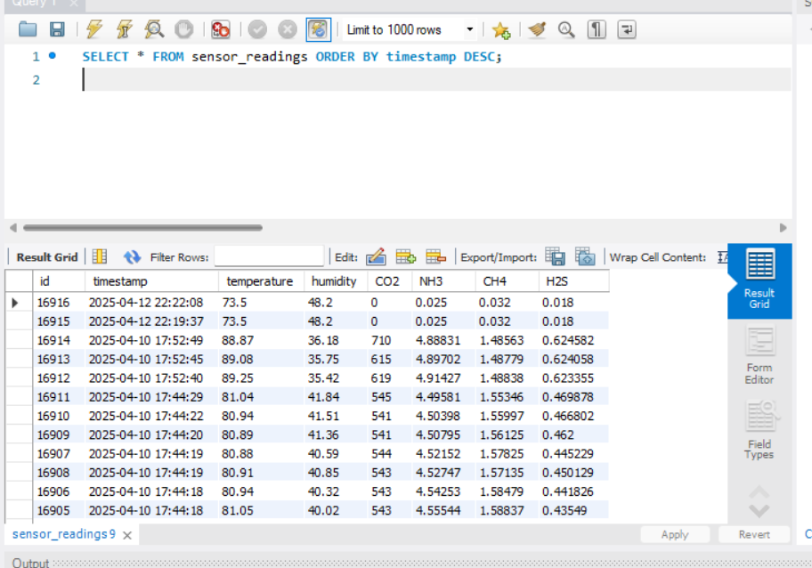
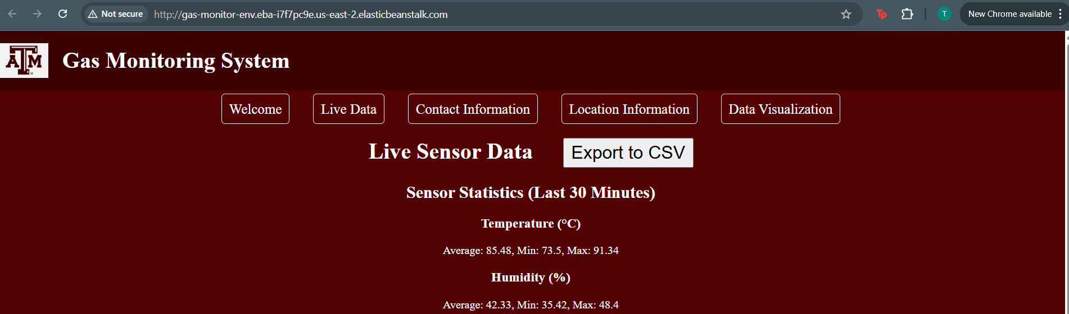
Engineering Design Accomplishments
Tanmay Sarkar
http://gas-monitor-env.eba-i7f7pc9e.us-east-2.elasticbeanstalk.com/
Created a realistic auto-generating database which went into a locally hosted web application.
This was used for testing/validation
Gradually increasing rate/volume of data to test the efficiency of the website/database.
Integrated real time data from AWS which was fed from an ESP32 Microcontroller

Slide 14
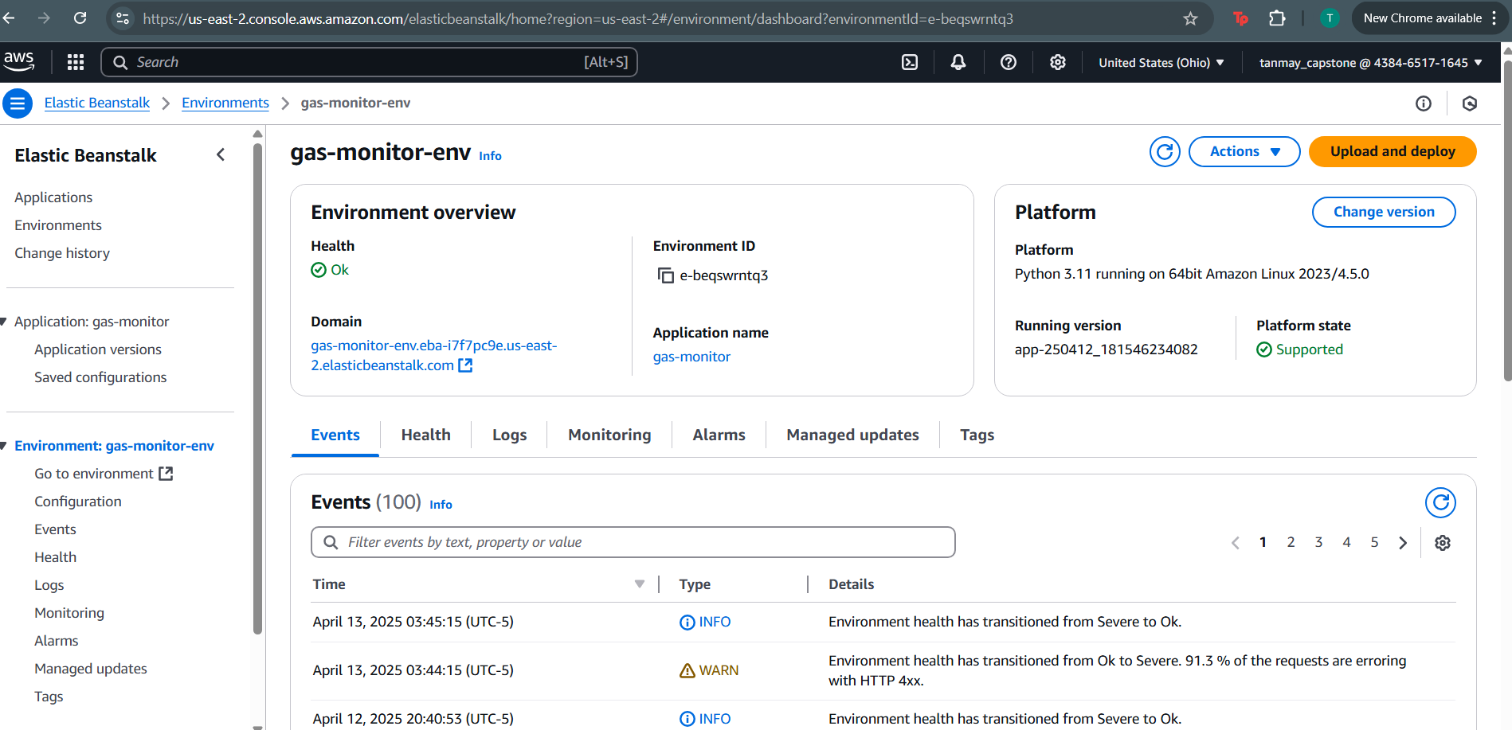

Slide 15
Engineering Design Accomplishments
Tanmay Sarkar
Built a MySQL Database hosted by AWS (Relational Database Services)
Managed by MySQL Workbench.
Flask web application with real time data updating and CSV export capabilities
Link
Challenges | Solutions
Connection of AWS Lambda to MySQL Database | Debugging python script that was being uploaded to Lambda by breaking it down part by part.
Keeping website updated as more sensors were added on and the JSON text format was changing | Keeping track of the order of the sensors and updating each part of the software flow one at a time.
Website deployment | Debugging the folder structure of my project and reading the EB (elastic beanstalk) logs

Slide 16
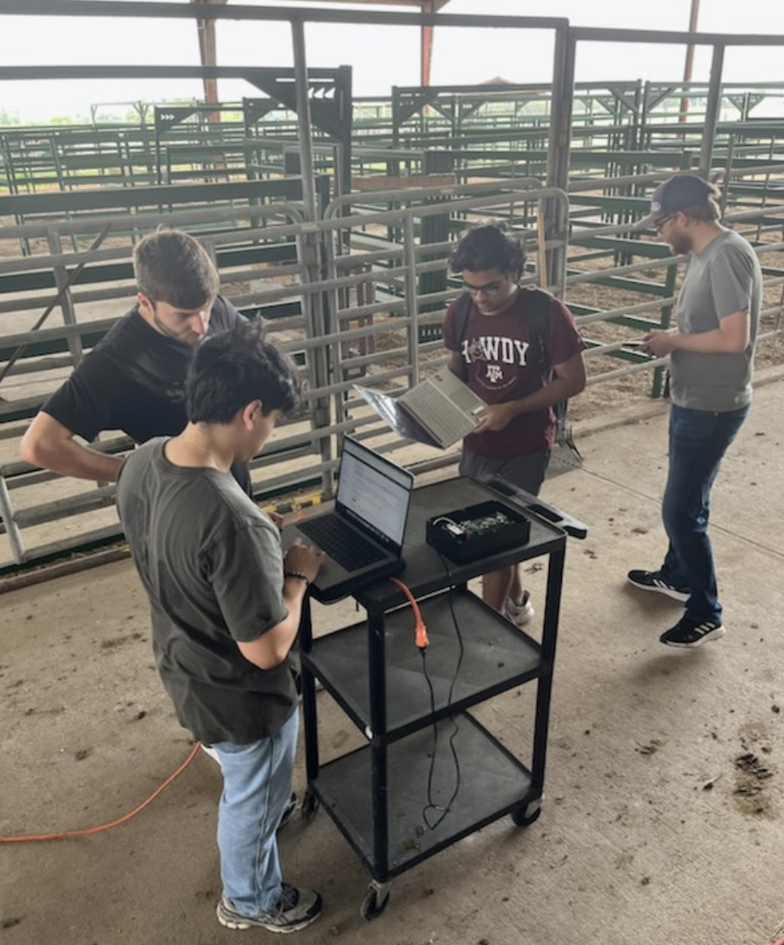
Integrated System Results
Farm Visit #1 with Sponsor Justin Houck:
Met sponsors expectations
Collected an hours worth of data
Data sent to sponsor for analysis
Farm Visit #2 on Thursday, April 17th

Slide 17
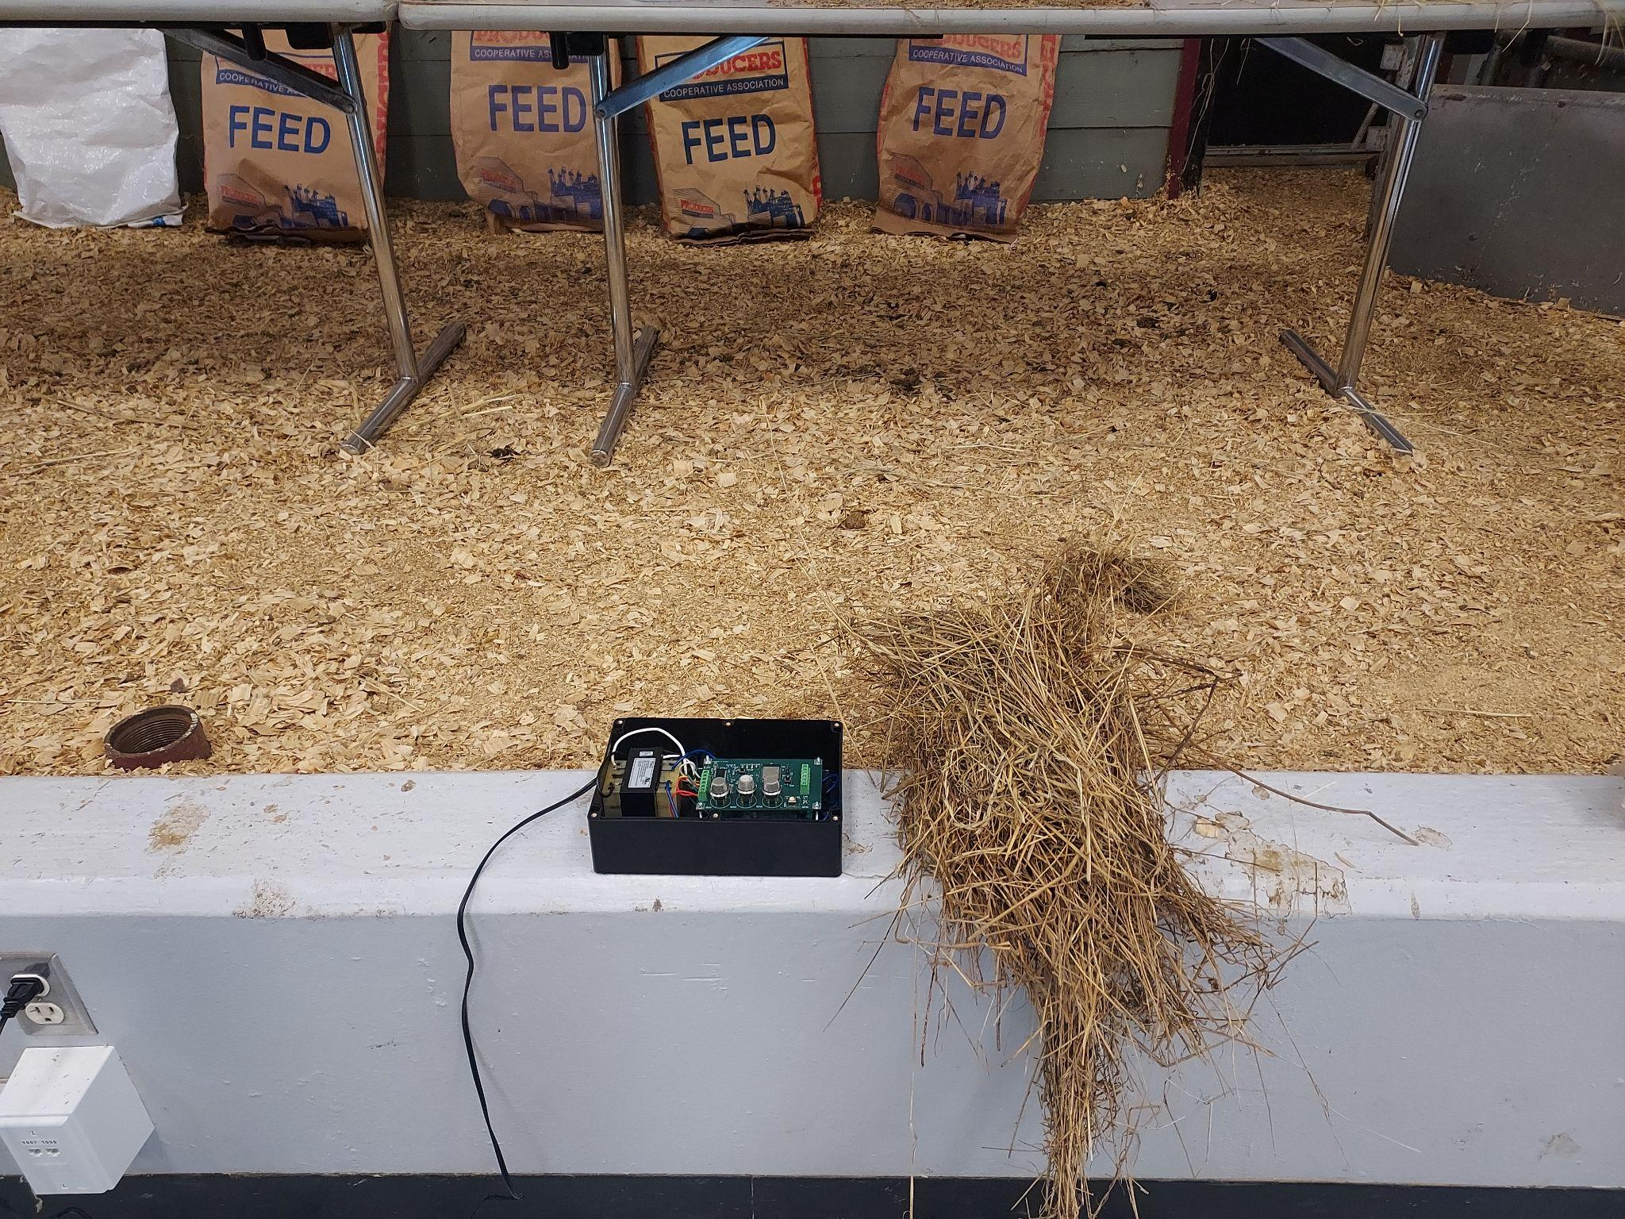
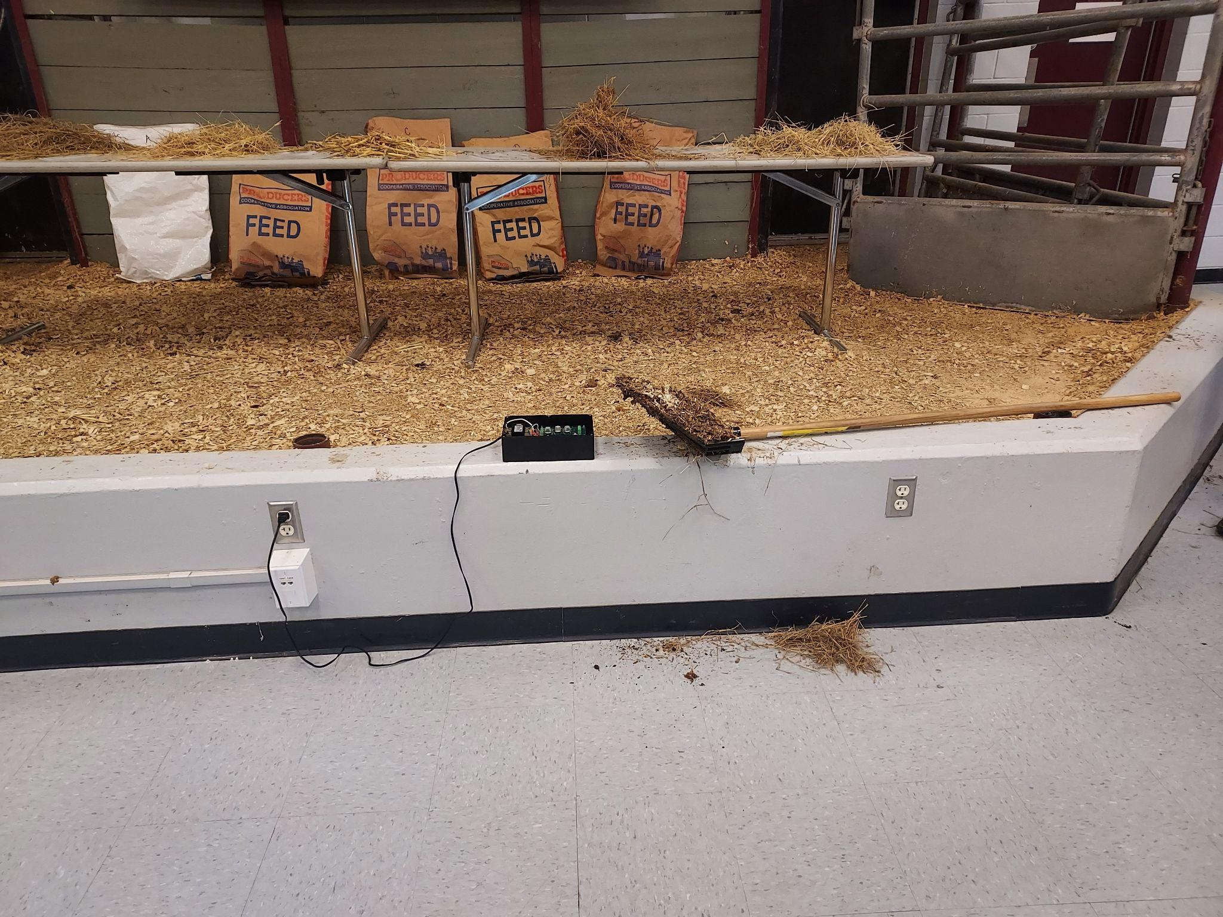
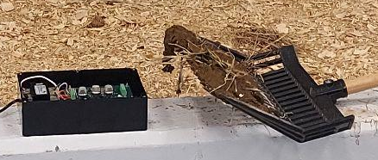
Integrated System Results
Test 1 | Room State | 11:46
Test 2 | Cow Patty | 11:55
Test 3 | Damp Cattle Bedding | 12:06

Slide 18
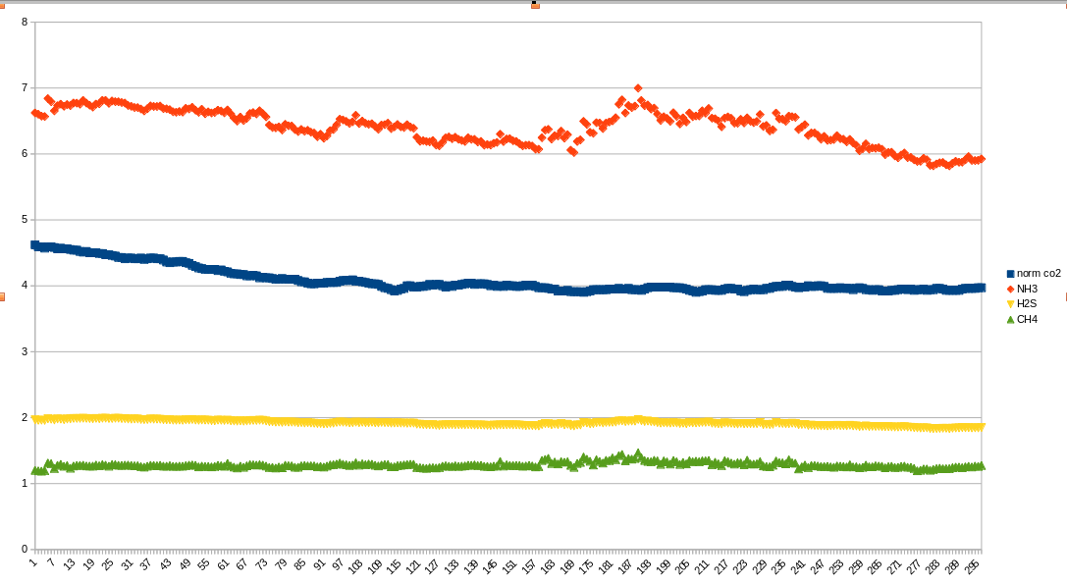
Integrated System Results
Red: NH3
Blue: CO2
Yellow: H2S
Green: CH4
Most significant detection in NH3 and CO2. H2S and CH4 detection less present.

Slide 19
Conclusions
Moved from LoRaWAN to Wi-Fi due to ease of use, cost, and requirements
Temperature reads higher due to system heat
Current status:
Integration, Test, and Validation Complete
Second field test April 17th to collect more data with highly detailed experimental plan

